Slide 1

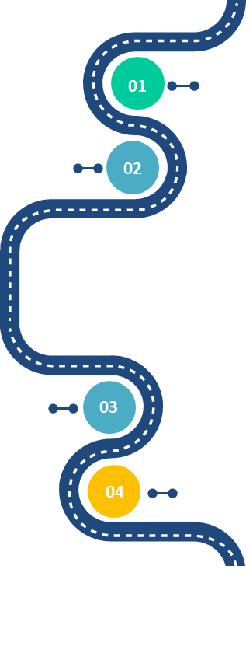








COMMUNITIES
OF
Practices
DEVELOP
ARCHITECTURE COMMUNITY
people empowerment and architecture skills
Architecture Skills
DELIVERY
TEAM
Be able to empower the new roles, to put in place architecture rituals and relevant new practices
EXPERT
Technical Knowledge
ALIGNMENT
+
AUTONOMY
>
CONTROL
Know the reference Architecture, styles and patterns promoted by the Architecture communities
RUN
The Architecture Academy roadtrip
ARCHITECTURE RISK
3
MANDATORY
EA STEERING REVIEW
REQUIRES REGULAR
AUTONOMY ASSESMENT
2
FULL STACK
and/or PRODUCT
ARCHITECTS EMBEDDED
TEAM AUTONOMY
1
Business Knowledge
TEAM SQUAD
AUTONOMY
Know more the business ecosystem and evolution to develop architecture value
Architecture leadership
Develop architecture leadership thanks to personal and collective development.
Notes:
3 pilars of the academy
Architecture Skills
Technical and Business Knowledge
Architecture leadership
CoP
Risk assessment : Continuous Architecture implementation plan

